Slide 1

Java Slides part-I
By Aman Tiwari

Slide 2
What is Java?
Java is a widely-used High level programming language for coding. It has been a popular choice among developers for over two decades, with millions of Java applications in use today. Java is a multi-platform(hardware+OS), object-oriented, and network-centric language that can be used as a platform in itself. It is a fast, Highly secure, reliable programming language for coding everything from mobile apps and enterprise software to big data applications and server-side technologies.
How to program in Java
To begin programming in Java, you need to install a Java Edition on your system. There are three main Java editions:
Java Standard Edition (Java SE)
Java Enterprise Edition (Java EE)
Java Micro Edition (Java ME)
What is Java SE?
Java Standard Edition is the core Java programming platform. It contains all of the libraries and APIs that any programmer needs for java development. Open Java Development Kit(OpenJDK) is the free and open source implementation of Java SE.

Slide 3
Application
According to Sun Micro System, 3 billion devices run Java. There are many devices where Java is currently used. Some of them are as follows:
Desktop Applications such as acrobat reader, media player, antivirus, etc.
Web Applications such as irctc.co.in, javatpoint.com, etc.
Enterprise Applications such as banking applications.
Mobile Apps
Embedded System
Smart Card
Robotics
Games
Testing
Big data etc

Slide 4
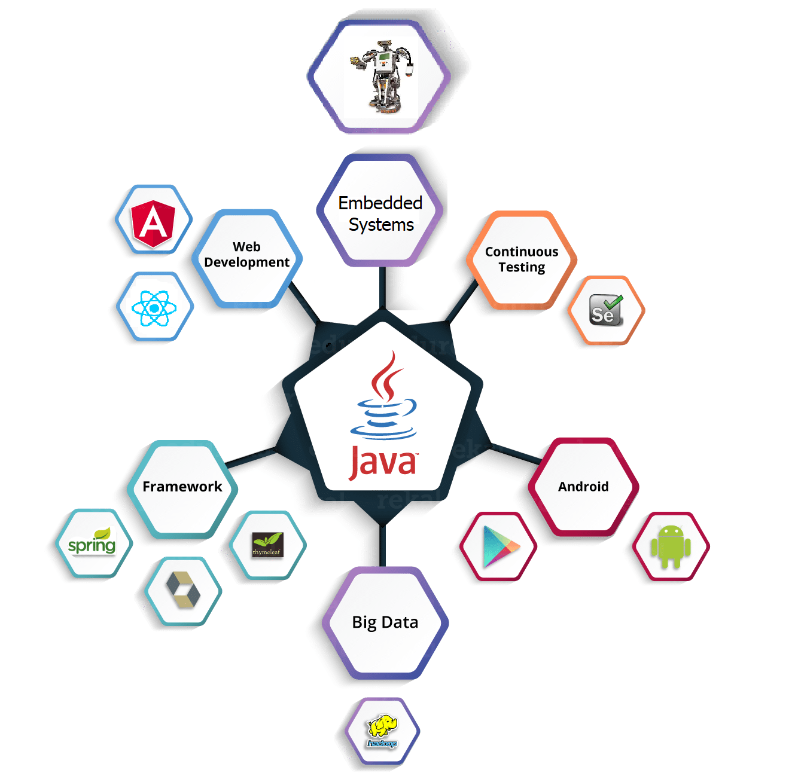


Slide 5
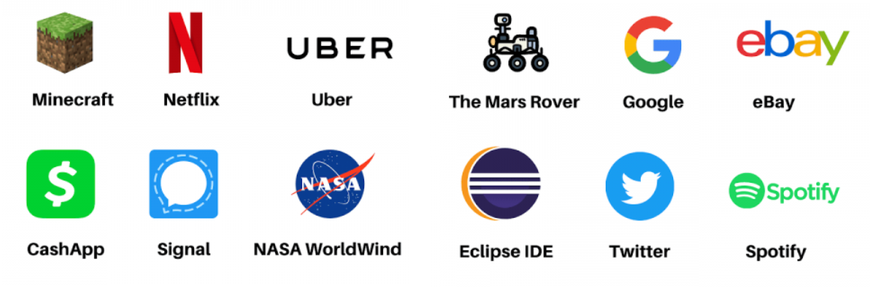
Top Applications Build using Java

Slide 6
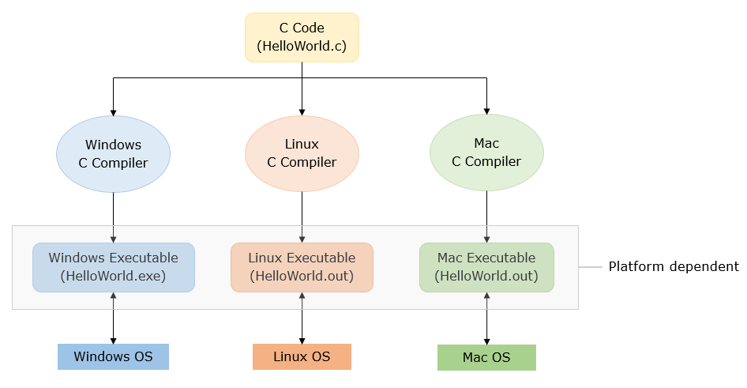
Features of java
If a program written on a particular platform can run on other platforms without any recompilation, it is known as platform independence.Since Java is platform-independent, any program written using Java on Windows will execute without any recompilation on any other platform.To see what platform independence actually is and how it matters, let us compare Java to a platform-dependent language like C.

Slide 7
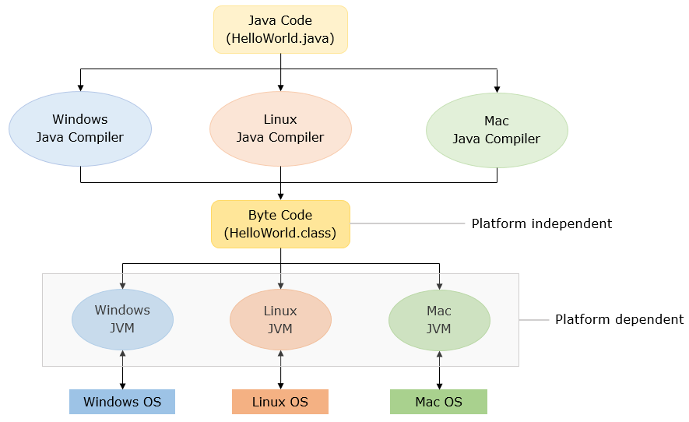
Java is platform-independent whereas JVM is platform dependent. Let us see how Java code executes in different platforms.
JRE

Slide 8
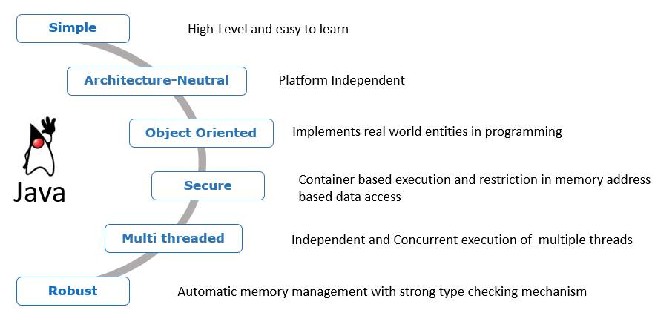

Slide 9
Object-oriented
Java is an object-oriented programming language. Everything in Java is an object. Object-oriented means we organize our software as a combination of different types of objects that incorporates both data and behavior.
Object-oriented programming (OOPs) is a software developement methodology that simplifies software development and maintenance by providing some rules.
Basic concepts of OOPs are:
Class
Object
Inheritance
Polymorphism
Abstraction
Encapsulation

Slide 10
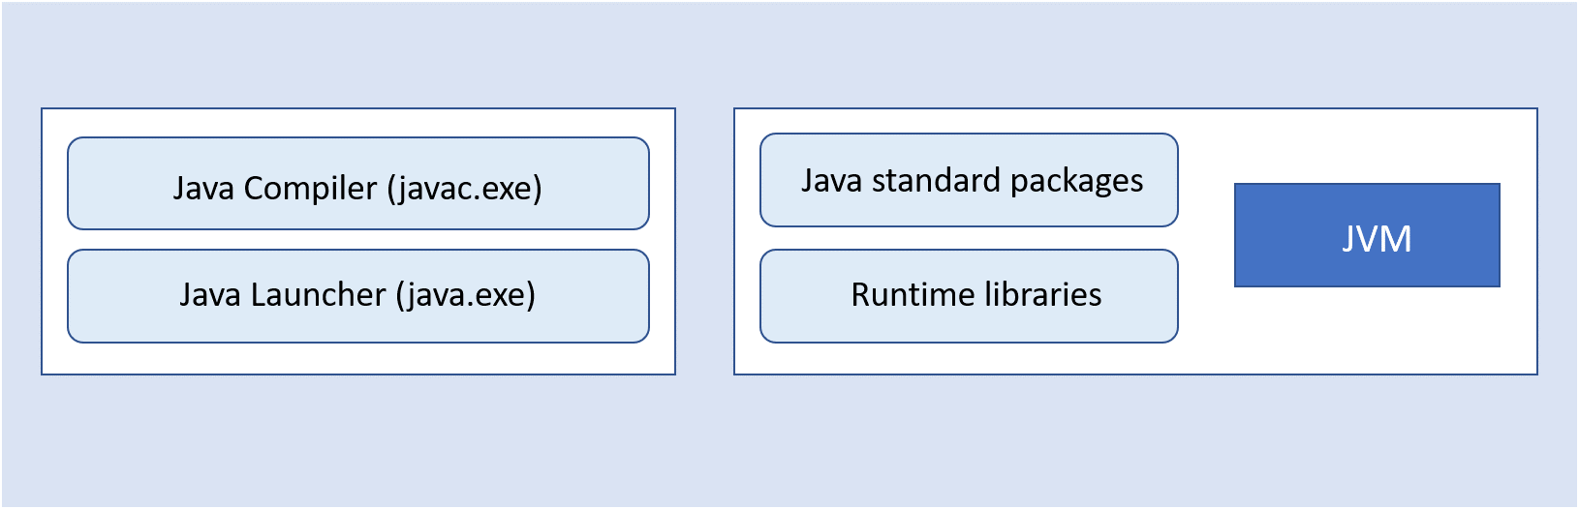
A Java program requires a Java development kit (JDK) for library support and development tools.
Java compiler (javac.exe): A Java compiler is a program that converts source files into the respective byte code. The byte code is platform-independent.
Java launcher (java.exe): Java launcher launches the Java application.
Java standard packages and runtime libraries contain the necessary code for executing Java applications.
Note: Previously, JDK came with a separate implementation for JRE (Java Runtime Environment). Now, starting from Java 11, Adopt OpenJDK does not come with separate JRE implementation; JDK will include JRE implementation. We will be using Adopt OpenJDK in this course.
JDK
JRE

Slide 11
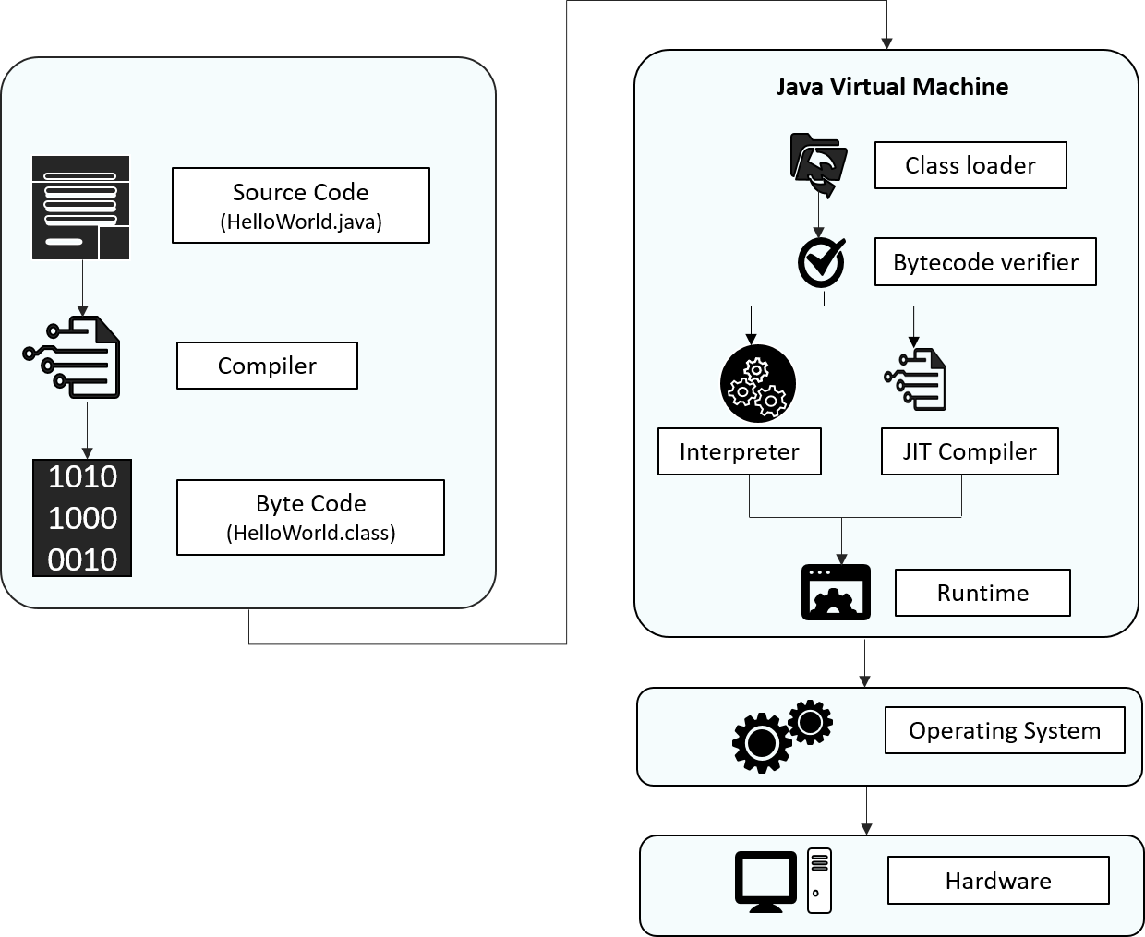
JAVA Architecture

Slide 12
Source code: Program written in Java language
Byte code: A .class file is generated after the Java code is compiled
ClassLoader: Loads all the class files needed for execution
Byte code verifier: Checks code for fragments for illegal code
Interpreter: Converts byte code instruction to machine code
Compiler: Compiles reusable byte code instructions to machine code
Runtime: The overall execution of the program is assisted by Runtime.
JIT : just in time compilation

Slide 13
First Java Program | Hello World Example
The requirement for Java Hello World Example
For executing any java program, you need to Install the JDK if you don't have installed it,
download the JDK and install it.
Set path of the jdk/bin directory (only in below JDK 11).
Create the java program
Let's create the hello world program in java (make a file Simple.java):
class Simple
{
public static void main(String args[ ]){
System.out.println("Hello Everyone");
}
}
save this file as Simple.java
TO COMPILE javac Simple.java
TO EXECUTE/RUN java Simple

Slide 14
Parameters used in First Java Program
Let's see what is the meaning of class, public, static, void, main, String[ ], System.out.println().
class keyword is used to declare a class in java.
public keyword is an access modifier which represents visibility. It means it is visible to all.
static is a keyword. If we declare any method as static, it is known as the static method. The core advantage of the static method is that there is no need to create an object to invoke the static method. The main method is executed by the JVM, so it doesn't require to create an object to invoke the main method. So it saves memory.
void is the return type of the method. It means it doesn't return any value.
main represents the starting point of the program.
String[ ] args is used for command line argument. We will learn it later.

Slide 15
System.out.println() is used to print statement. Here, System is a class, out is the object of PrintStream class, println() is the method of PrintStream class.
How many ways can we write a Java program
Valid java main method signature
public static void main(String[] args)
public static void main(String []args)
public static void main(String args[])
public static void main(String... args)
static public void main(String[] args)
public static final void main(String[] args)
final public static void main(String[] args)
final strictfp public static void main(String[] args)

Slide 16
Invalid java main method signature
public void main(String[] args)
static void main(String[] args)
public void static main(String[] args)
abstract public static void main(String[] args)

Slide 17
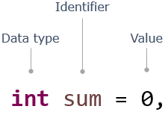
Java Keywords and data type
In programs, data values are stored in memory locations identified by names (identifiers). Such named memory locations are called variables.
Notice how variables are declared using types, identifiers, and assigned values:
As you have seen, a program is composed of several components, blocks, and words.
Some of these words are reserved and have a special meaning in Java, e.g. class, public, void, for, int, static. These words are called keywords. There are 50 keywords in Java 8.

Slide 18
Rules for Naming a Identifier ( Variable )
case sensitive
should not start with a number
should start with a letter, $ or _
should not have spaces
should not be a Java keyword or a literal
no restriction on the length
Note: The identifier should not have the only _ in its name.
Example :
Valid Identifiers: CustomerName, grade_in_first_attempt, marksScoredIn3rdAttempt
Invalid Identifiers: model number, 1ofAKind, double

Slide 19
Types of Variables
There are three types of variables in java:
local variable
instance variable
static variable
We will study about them in later chapters

Slide 20
Java Variable Example: Add Two Numbers
public class Simple
{
public static void main(String[] args)
{
int a=10;
int b=10;
int c=a+b;
System.out.println(c);
}
}

Slide 21
Data Types in Java
Data types specify the different sizes and values that can be stored in the variable. There are two types of data types in Java:
1. Primitive data types: The primitive data types include boolean, char, byte, short, int, long, float and double.
There are 8 types of primitive data types:
boolean data type
byte data type
char data type
short data type
int data type
long data type
float data type
double data type

Slide 22
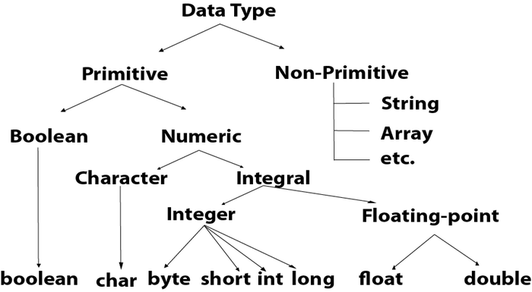
2. Non-primitive data types: The non-primitive data types include Classes, Interfaces, and Arrays.

Slide 23
Operators in java :
Operator in java is a symbol that is used to perform operations. For example: +, -, *, / etc.
There are many types of operators in java which are given below:
Unary Operator,
Arithmetic Operator,
Shift Operator,
Relational Operator,
Bitwise Operator,
Logical Operator,
Ternary Operator and
Assignment Operator.

Slide 24
Operator Type | Category | Precedence
Unary | postfix | expr++ expr--
 | prefix | ++expr --expr +expr -expr ~ !
Arithmetic | multiplicative | * / %
 | additive | + -
Shift | shift | << >> >>>
Relational | comparison | < > <= >= instanceof
 | equality | == !=
Bitwise | bitwise AND | &
 | bitwise exclusive OR | ^
 | bitwise inclusive OR | |
Logical | logical AND | &&
 | logical OR | ||
Ternary | ternary | ? :
Assignment | assignment | = += -= *= /= %= &= ^= |= <<= >>= >>>=

Slide 25
Java Unary Operator
The Java unary operators require only one operand. Unary operators are used to perform various operations i.e.:
incrementing/decrementing a value by one
negating an expression
inverting the value of a Boolean
Java Unary Operator Example: ++ and --
public class OperatorExample{
public static void main(String args[]){
int x=10;
System.out.println(x++);//10 (11)
System.out.println(++x);//12
System.out.println(x--);//12 (11)
System.out.println(--x);//10
}}

Slide 26
Java Unary Operator Example 2: ++ and –-
public class OperatorExample{
public static void main(String args[]){
int a=10;
int b=10;
System.out.println(a++ + ++a);//10+12=22
System.out.println(b++ + b++);//10+11=21
}}

Slide 27
Java Unary Operator Example: ~ and !
public class OperatorExample{
public static void main(String args[]){
int a=10;
int b=-10;
boolean c=true;
boolean d=false;
System.out.println(~a);//-11 (minus of total positive value which starts from 0)
System.out.println(~b);//9 (positive of total minus, positive starts from 0)
System.out.println(!c);//false (opposite of boolean value)
System.out.println(!d);//true
}
}

Slide 28
Java Arithmetic Operators
Java arithmetic operators are used to perform addition, subtraction, multiplication, and division. They act as basic mathematical operations.
Java Arithmetic Operator Example
public class OperatorExample{
public static void main(String args[]){
int a=10;
int b=5;
System.out.println(a+b);//15
System.out.println(a-b);//5
System.out.println(a*b);//50
System.out.println(a/b);//2
System.out.println(a%b);//0
}}

Slide 29
Java Arithmetic Operator Example: Expression
class OperatorExample{
public static void main(String args[]){
System.out.println(10*10/5+3-1*4/2); //21
}}
Java Left Shift Operator
The Java left shift operator << is used to shift all of the bits in a value to the left side of a specified number of times.
public class OperatorExample{
public static void main(String args[]){
System.out.println(10<<2);//10*2^2=10*4=40
System.out.println(10<<3);//10*2^3=10*8=80
System.out.println(20<<2);//20*2^2=20*4=80
System.out.println(15<<4);//15*2^4=15*16=240
}}

Slide 30
Java Right Shift Operator
The Java right shift operator >> is used to move left operands value to right by the number of bits specified by the right operand.
Java Right Shift Operator Example
public class OperatorExample{
public static void main(String args[]){
System.out.println(10>>2);//10/2^2=10/4=2
System.out.println(20>>2);//20/2^2=20/4=5
System.out.println(20>>3);//20/2^3=20/8=2
}}

Slide 31
Java AND Operator Example: Logical && and Bitwise &
The logical && operator doesn't check second condition if first condition is false. It checks second condition only if first one is true.
The bitwise & operator always checks both conditions whether first condition is true or false.
public class OperatorExample{
public static void main(String args[]){
int a=10;
int b=5;
int c=20;
System.out.println(a<b&&a<c);//false && true = false
System.out.println(a<b&a<c);//false & true = false
}}

Slide 32
Java AND Operator Example: Logical && vs Bitwise &
public class OperatorExample{
public static void main(String args[]){
int a=10;
int b=5;
int c=20;
System.out.println(a<b&&a++<c);//false && true = false
System.out.println(a);//10 because second condition is not checked
System.out.println(a<b&a++<c);//false && true = false
System.out.println(a);//11 because second condition is checked
}}

Slide 33
Java OR Operator Example: Logical || and Bitwise |
The logical || operator doesn't check second condition if first condition is true. It checks second condition only if first one is false.
The bitwise | operator always checks both conditions whether first condition is true or false.
public class OperatorExample{
public static void main(String args[]){
int a=10;
int b=5;
int c=20;
System.out.println(a>b||a<c);//true || true = true
System.out.println(a>b|a<c);//true | true = true
//|| vs |
System.out.println(a>b||a++<c);//true || true = true
System.out.println(a);//10 because second condition is not checked
System.out.println(a>b|a++<c);//true | true = true
System.out.println(a);//11 because second condition is checked
}}

Slide 34
Java Ternary Operator
Java Ternary operator is used as one liner replacement for if-then-else statement and used a lot in java programming. it is the only conditional operator which takes three operands.
Java Ternary Operator Example
class OperatorExample{
public static void main(String args[]){
int a=2;
int b=5;
int min=(a<b)?a:b;
System.out.println(min);
}}

Slide 35
Conditional Statements
If-else Statement
The Java if statement is used to test the condition. It checks boolean condition: true or false. There are various types of if statement in java.
if statement
if-else statement
if-else-if ladder
nested if statement

Slide 36
public class IfExample {
public static void main(String[] args) {
//defining an 'age' variable
int age=20;
//checking the age
if(age>18){
System.out.print("Age is greater than 18");
}
}
}

Slide 37
if-else Statement
The Java if-else statement also tests the condition. It executes the if block if condition is true otherwise else block is executed.
public class IfElseExample {
public static void main(String[] args) {
//defining a variable
int number=13;
//Check if the number is divisible by 2 or not
if(number%2==0){
System.out.println("even number");
}else{
System.out.println("odd number");
} }}

Slide 38
public class IfElseIfExample {
public static void main(String[] args) {
int marks=65;
if(marks<50){
System.out.println("fail");
}
else if(marks>=50 && marks<60){
System.out.println("D grade");
}
else if(marks>=60 && marks<70){
System.out.println("C grade");
}
else if(marks>=70 && marks<80){
System.out.println("B grade");
}
else if(marks>=80 && marks<90){
System.out.println("A grade");
} else{
System.out.println("Invalid!");
} }}

Slide 39
Nested if statement
The nested if statement represents the if block within another if block. Here, the inner if block condition executes only when outer if block condition is true.
public class JavaNestedIfExample {
public static void main(String[] args) {
//Creating two variables for age and weight
int age=20;
int weight=80;
//applying condition on age and weight
if(age>=18){
if(weight>50){
System.out.println("You are eligible to donate blood");
}
}
}}

Slide 40
Switch Statement
The Java switch statement executes one statement from multiple conditions. It is like if-else-if ladder statement. The switch statement works with byte, short, int, long, enum types, String and some wrapper types like Byte, Short, Int, and Long. Since Java 7, you can use strings in the switch statement
In other words, the switch statement tests the equality of a variable against multiple values.
Points to Remember
There can be one or N number of case values for a switch expression.
The case value must be of switch expression type only. The case value must be literal or constant. It doesn't allow variables.
The case values must be unique. In case of duplicate value, it renders compile-time error.
The Java switch expression must be of byte, short, int, long (with its Wrapper type), enums and string.
Each case statement can have a break statement which is optional. When control reaches to the break statement, it jumps the control after the switch expression. If a break statement is not found, it executes the next case.

Slide 41
public class SwitchExample {
public static void main(String[] args) {
//Declaring a variable for switch expression
int number=20;
//Switch expression
switch(number){
//Case statements
case 10: System.out.println("10");
break;
case 20: System.out.println("20");
break;
case 30: System.out.println("30");
break;
//Default case statement
default:System.out.println("Not in 10, 20 or 30");
}
} }

Slide 42
Java Switch Statement is fall-through
The Java switch statement is fall-through. It means it executes all statements after the first match if a break statement is not present.
public class SwitchExample2 {
public static void main(String[] args) {
int number=20;
//switch expression with int value
switch(number){
//switch cases without break statements
case 10: System.out.println("10");
case 20: System.out.println("20");
case 30: System.out.println("30");
default:System.out.println("Not in 10, 20 or 30");
}
} }

Slide 43
Loops in java
In programming languages, loops are used to execute a set of instructions/functions repeatedly when some conditions become true. There are three types of loops in java.
for loop
The Java for loop is a control flow statement that iterates a part of the programs multiple times. If the number of iteration is fixed, it is recommended to use for loop.
public class ForExample {
public static void main(String[] args) {
//Code of Java for loop
for(int i=1;i<=10;i++){
System.out.println(i);
}} }

Slide 44
Java Infinitive For Loop
If you use two semicolons ;; in the for loop, it will be infinitive for loop.
Syntax:
public class ForExample {
public static void main(String[] args) {
//Using no condition in for loop
for(;;){
System.out.println("infinitive loop");
}
}
}
press ctrl+c to exit from the program

Slide 45
while loop
The Java while loop is a control flow statement that executes a part of the programs repeatedly on the basis of given boolean condition. If the number of iteration is not fixed, it is recommended to use while loop.
public class WhileExample {
public static void main(String[] args) {
int i=1;
while(i<=10){
System.out.println(i);
i++;
}
}
}

Slide 46
Infinitive While Loop
If you pass true in the while loop, it will be infinitive while loop.
public class WhileExample2 {
public static void main(String[] args) {
while(true){
System.out.println("infinitive while loop");
}
}
}

Slide 47
do-while loop
The Java do while loop is a control flow statement that executes a part of the programs at least once anIf the number of iteration is not fixed and you must have to execute the loop at least once, it is recommended to use the do-while loop.d the further execution depends upon the given boolean condition.
public class DoWhileExample {
public static void main(String[] args) {
int i=1;
do{
System.out.println(i);
i++;
}while(i<=10);
}
}

Slide 48
Infinitive do-while Loop
If you pass true in the do-while loop, it will be infinitive do-while loop.
public class DoWhileExample2 {
public static void main(String[] args) {
do{
System.out.println("infinitive do while loop");
}while(true);
}
}

Slide 49
Break Statement
When a break statement is encountered inside a loop, the loop is immediately terminated and the program control resumes at the next statement following the loop.
The Java break is used to break loop or switch statement. It breaks the current flow of the program at specified condition. In case of inner loop, it breaks only inner loop.
We can use Java break statement in all types of loops such as for loop, while loop and do-while loop.
Syntax:
jump-statement;
break;

Slide 50
public class BreakExample {
public static void main(String[] args) {
//using for loop
for(int i=1;i<=10;i++){
if(i==5){
//breaking the loop
break;
}
System.out.println(i);
}
}
}

Slide 51
Break Statement with Inner Loop
It breaks inner loop only if you use break statement inside the inner loop.
Example:
//Java Program to illustrate the use of break statement
//inside an inner loop
public class BreakExample2 {
public static void main(String[] args) {
//outer loop
for(int i=1;i<=3;i++){
//inner loop
for(int j=1;j<=3;j++){
if(i==2&&j==2){
//using break statement inside the inner loop
break;
}
System.out.println(i+" "+j);
}
} } }

Slide 52
Break Statement in while loop
Example:
//Java Program to demonstrate the use of break statement
//inside the while loop.
public class BreakWhileExample {
public static void main(String[] args) {
//while loop
int i=1;
while(i<=10){
if(i==5){
//using break statement
i++;
break;//it will break the loop
}
System.out.println(i);
i++;
} }}

Slide 53
Break Statement in do-while loop
Example:
//Java Program to demonstrate the use of break statement
//inside the Java do-while loop.
public class BreakDoWhileExample {
public static void main(String[] args) {
//declaring variable
int i=1;
//do-while loop
do{
if(i==5){
//using break statement
i++;
break;//it will break the loop
}
System.out.println(i);
i++;
}while(i<=10);
} }

Slide 54
Continue Statement
The continue statement is used in loop control structure when you need to jump to the next iteration of the loop immediately. It can be used with for loop or while loop.
The Java continue statement is used to continue the loop. It continues the current flow of the program and skips the remaining code at the specified condition. In case of an inner loop, it continues the inner loop only.
We can use Java continue statement in all types of loops such as for loop, while loop and do-while loop.
Syntax:
jump-statement;
continue;

Slide 55
public class ContinueExample {
public static void main(String[] args) {
//for loop
for(int i=1;i<=10;i++){
if(i==5){
//using continue statement
continue;//it will skip the rest statement
}
System.out.println(i);
}
}
}

Slide 56
Continue Statement with Inner Loop
It continues inner loop only if you use the continue statement inside the inner loop.
public class ContinueExample2 {
public static void main(String[] args) {
//outer loop
for(int i=1;i<=3;i++){
//inner loop
for(int j=1;j<=3;j++){
if(i==2&&j==2){
//using continue statement inside inner loop
continue;
}
System.out.println(i+" "+j);
} }}}

Slide 57
Types of Java Comments
There are 3 types of comments in java.
Single Line Comment
//This is single line comment
Multi Line Comment
/*
multi line
comment
*/
Documentation Comment
/**
documentation
comment
*/

Slide 58
Java Naming conventions
Java naming convention is a rule to follow as you decide what to name your identifiers such as class, package, variable, constant, method, etc
Advantage of naming conventions in java
The following are the key rules that must be followed by every identifier:
The name must not contain any white spaces.
The name should not start with special characters like & (ampersand), $ (dollar), _ (underscore).

Slide 59
What is a class in Java
A class is a group of objects which have common properties. It is a template or blueprint from which objects are created. It is a logical entity. It can't be physical.
A class in Java can contain:
Fields
Methods
Constructors
Blocks
Nested class and interface
Method in Java
In Java, a method is like a function which is used to expose the behavior of an object.
Advantage of Method
Code Reusability
Code Optimization

Slide 60
Class
It should start with the uppercase letter.
It should be a noun such as Color, Button, System, Thread, etc.
Use appropriate words, instead of acronyms.
Example: -
public class Employee
{
//code snippet
}

Slide 61
What is an object in Java
An object has three characteristics:
State:represents the data (value) of an object.
Behavior: represents the behavior (functionality) of an object such as deposit, withdraw, etc.
Identity: An object identity is typically implemented via a unique ID. The value of the ID is not visible to the external user. However, it is used internally by the JVM to identify each object uniquely.
Object Definitions:
An object is a real-world entity.
An object is a runtime entity.
The object is an entity which has state and behavior.
The object is an instance of a class.

Slide 62
new keyword in Java
The new keyword is used to allocate memory at runtime. All objects get memory in Heap memory area.
we created a Student class which has two data members id and name. We are creating the object of the Student class by new keyword and printing the object's value.
Here, we are creating a main() method inside the class.

Slide 63
Object and Class Example: main within the class
In this example, we have created a Student class which has two data members id and name. We are creating the object of the Student class by new keyword and printing the object's value.
public class Student{
//defining fields
int id;//field or data member or instance variable
String name;
//creating main method inside the Student class
public static void main(String args[]){
//Creating an object or instance
Student s1=new Student();//creating an object of Student
//Printing values of the object
System.out.println(s1.id);//accessing member through reference variable
System.out.println(s1.name);
} }

Slide 64
3 Ways to initialize object
There are 3 ways to initialize object in java.
By reference variable
By method
By constructor
Initialization through reference
class Student{
int id;
String name; }
class TestStudent2{
public static void main(String args[]){
Student s1=new Student();
s1.id=101;
s1.name=“Aman Tiwari";
System.out.println(s1.id+" "+s1.name);//printing members with a white space
} }

Slide 65
We can also create multiple objects and store information in it through reference variable
class Student{
int id;
String name;
}
class TestStudent3{
public static void main(String args[]){
//Creating objects
Student s1=new Student();
Student s2=new Student();
//Initializing objects
s1.id=101;
s1.name="Sonoo";
s2.id=102;
s2.name="Amit";
//Printing data
System.out.println(s1.id+" "+s1.name);
System.out.println(s2.id+" "+s2.name);
} }

Slide 66
Initialization through method
In this example, we are creating the two objects of Student class and initializing the value to these objects by invoking the insertRecord method.
class Student{
int rollno;
String name;
void insertRecord(int r, String n){
rollno=r;
name=n;
}
void displayInformation(){System.out.println(rollno+" "+name);}
}
class TestStudent4{
public static void main(String args[]){
Student s1=new Student();
Student s2=new Student();
s1.insertRecord(111,"Karan");
s2.insertRecord(222,"Aryan");
s1.displayInformation();
s2.displayInformation();
} }

Slide 67
Initialization through a constructor
class Employee{
int id; String name; float salary;
void insert(int i, String n, float s) { id=i; name=n; salary=s; }
void display(){System.out.println(id+" "+name+" "+salary);}
}
public class TestEmployee {
public static void main(String[] args) {
Employee e1=new Employee();
Employee e2=new Employee();
Employee e3=new Employee();
e1.insert(101,"ajeet",45000);
e2.insert(102,"irfan",25000);
e3.insert(103,"nakul",55000);
e1.display(); e2.display(); e3.display();
} }

Slide 68
Constructors in Java
In Java, a constructor is a block of codes similar to the method. It is called when an instance of the object is created, and memory is allocated for the object.
When is a constructor called
Every time an object is created using new() keyword, at least one constructor is called. It calls a default constructor.
Rules for creating Java constructor
There are two rules defined for the constructor.
Constructor name must be the same as its class name
A Constructor must have no explicit return type
A Java constructor cannot be abstract, static, final, and synchronized

Slide 69
Types of Java constructors
There are two types of constructors in Java:
Default constructor (no-arg constructor)
Parameterized constructor
Example of default constructor
we are creating the no-arg constructor in the Bike class.
class Bike1{
//creating a default constructor
Bike1(){System.out.println("Bike is created");}
//main method
public static void main(String args[]){
//calling a default constructor
Bike1 b=new Bike1();
} }

Slide 70
Parameterized Constructor
A constructor which has a specific number of parameters is called a parameterized constructor.
Why use the parameterized constructor?
The parameterized constructor is used to provide different values to the distinct objects. However, you can provide the same values also.

Slide 71
class Student4{
int id; String name;
//creating a parameterized constructor
Student4(int i,String n){ id = i; name = n; }
//method to display the values
void display(){System.out.println(id+" "+name);}
public static void main(String args[]){
//creating objects and passing values
Student4 s1 = new Student4(111,"Karan");
Student4 s2 = new Student4(222,"Aryan");
//calling method to display the values of object
s1.display();
s2.display();
} }

Slide 74

Thank You
amantiwari8861@gmail.com

